Slide 1
CS100 Tutorial 13
Weather data analysis and Visualization

Slide 2
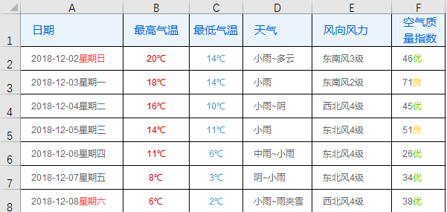
Preliminary
Download data file weather_data.xlsx from piazza, collected from http://tianqi.2345.com/wea_history/71146.htm
The file has Pudong’s weather data from July-December

Slide 3
Preliminary
Install NumPy, Pandas, Matplotlib
In order to read .xlsx format file, you might need to install xlrd
Check whether everything is correct by print the first five columns
import matplotlib.pyplot as plt
import numpy as np
import pandas as pd
data = pd.read_excel('weather_data.xlsx')
data.head()

Slide 4
Task 1: Data process
Divide
the column “日期” into two columns “日期” and “星期”
the column “天气” into two columns “最好天气” and “最坏天气” in the order of
晴>多云>阴>阵雨>雷阵雨>小雨>中雨>大雨>暴雨>雨夹雪>中雪
the column “风向风力” into three columns “风向” and “最低风速” and “最高风速”
the column “空气质量指数” into two columns “空气质量” and “空气指数”
remove ‘℃‘ in the “气温” columns

Slide 5
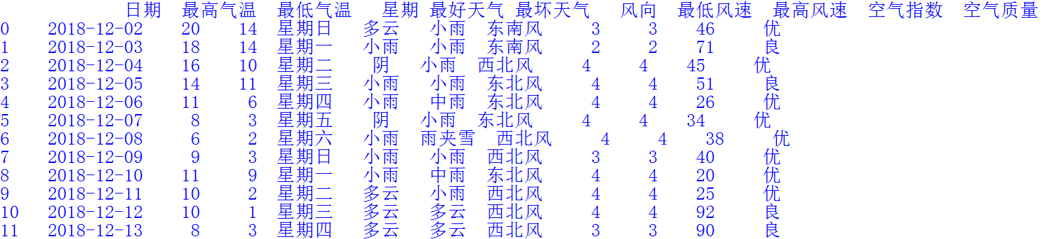
Task 1: Data process
Result:

Slide 6
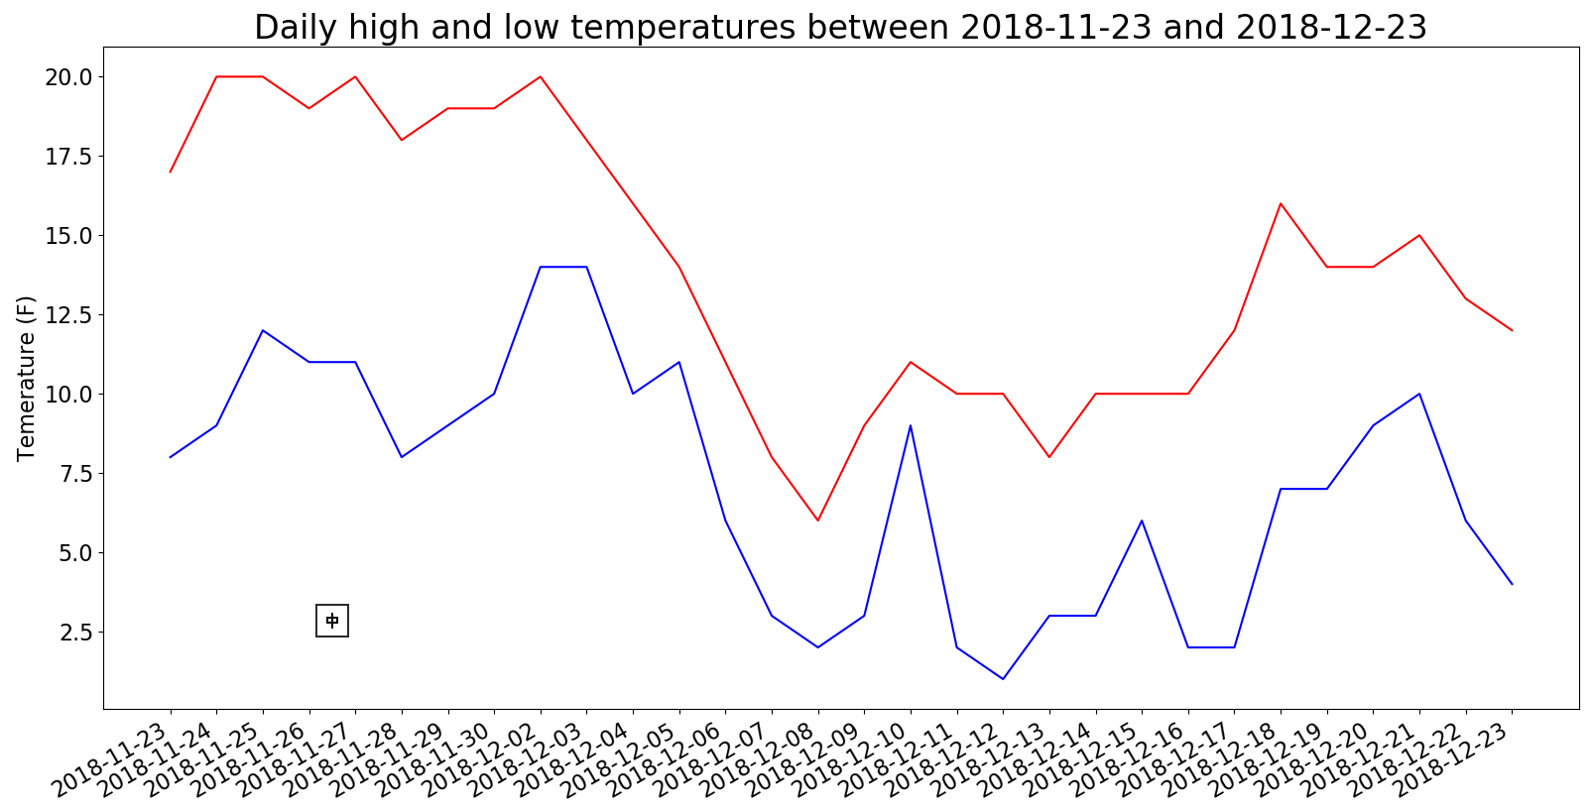
Task 2: Two Lines Plot
Draw the lines of “最高气温” and “最低气温” for latest 30 days
fig.autofmt_xdate() # format label of
x-axis

Slide 7
Task 3: Two subplots
Draw two plots, one is the plot in Task 2 and the another is the line of difference in temperature in the latest 30 days

Slide 8
